Slide 1

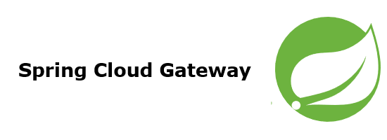
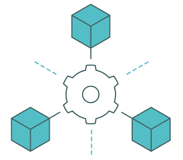

Eureka + Cloud Gateway + Open Feign using spring boot
OpenFeign
By
Hassan FARSI & Driss ALLAKI

Slide 2

Objectives
The objective of this demo is to :
Efficiently implement the API Gateway pattern using spring boot
Be able to implement the Application-level Service Discovery technique using the Eureka Netflix Server.
Easily communicate with the API exposed by the microservices using the OpenFein HTTP client.
Be able to combine all of these techniques in one spring boot project.

Slide 3


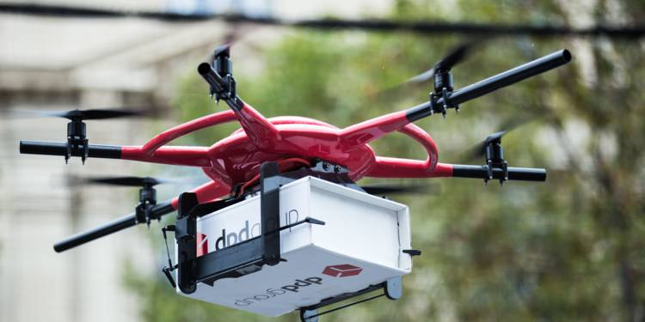

Case Study: RedHawk
Delivery by drones is very reliable and fast.
Delivery by drones minimizes cost and time.
Delivery must be accompanied by good management to ensure its reliability.
This work consists of designing and implementing a mobile application for managing the products delivery from a stock using drones.
The part we are interested in concerns the management of the product in the stock (we assume that the customer orders are done in person or by telephone).

Slide 4
Objectives
Facilitate the work of the employees which allows to easily process product requests and load orders.
Facilitate the management of all products in stock using the QR code technology.
Facilitate the knowledge of everything related to the shipment of the order.
Facilitate and ensure rapid access to information.

Slide 5
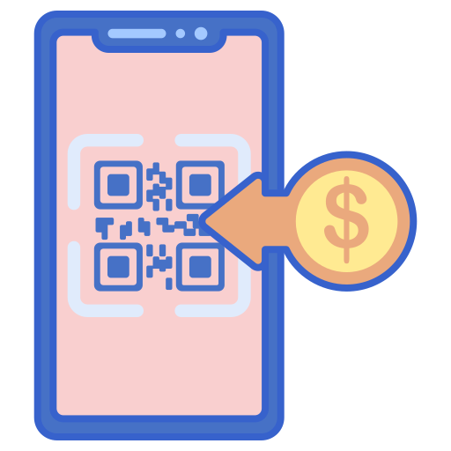
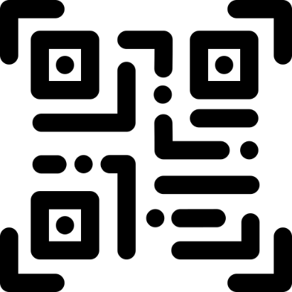
Business process
We suppose that the consumer has already submitted an order (we did not handle that part).
The shipment worker will use the order details to create a delivery order. They will provide the order products and the client information, including the delivery credentials.
After the shipment worker completes the delivery order, a QR code will be printed and pasted to the product container.
The employee responsible for the drone, will use the app to scan the code and provide all necessary data to the drone.
In case of drone problems, the delivery could be handled by the traditional way. The app provides a map with the shortest path to the destination.

Slide 6
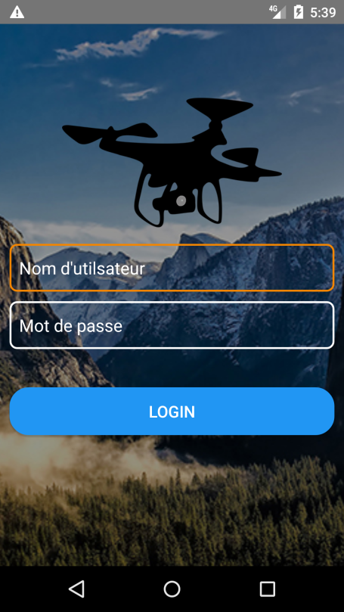
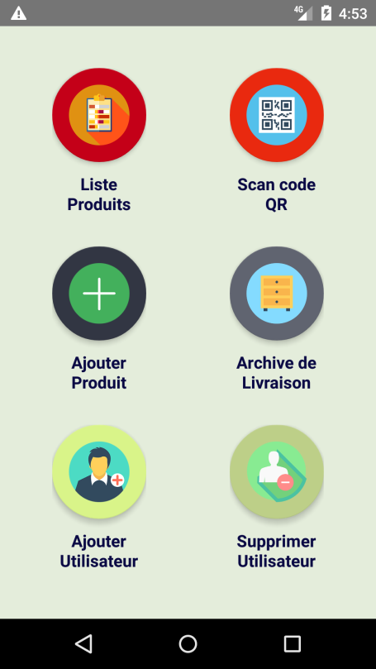
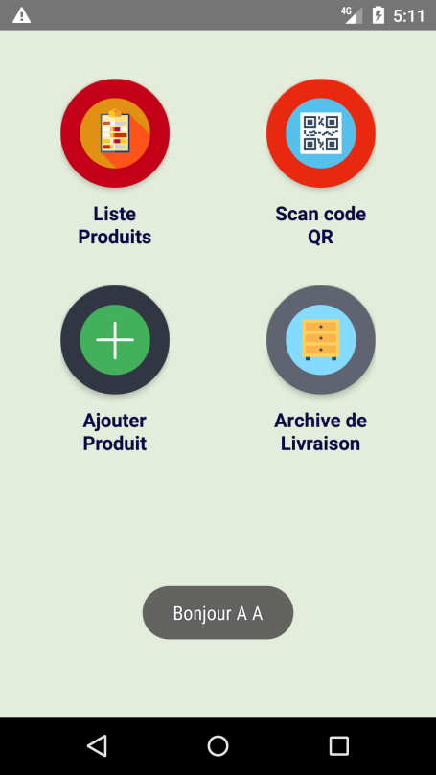
RedHawk presentation
The application interfaces : The basic windows of the application are :
Authentication interface
Main administrator interface.
Main employees interface.

Slide 7
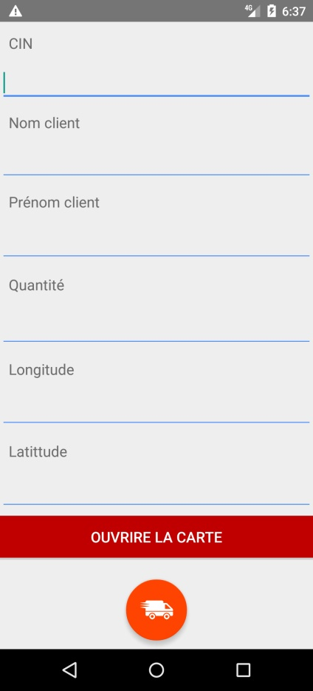
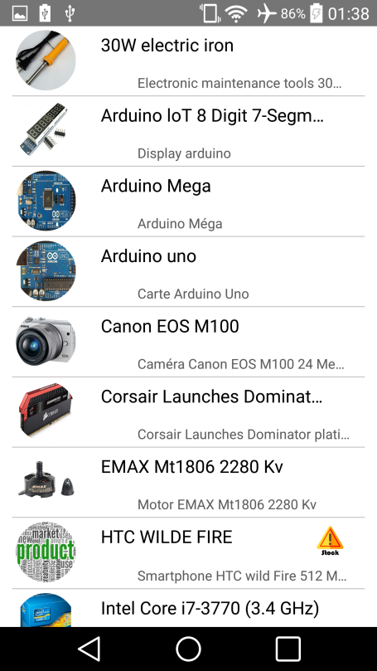
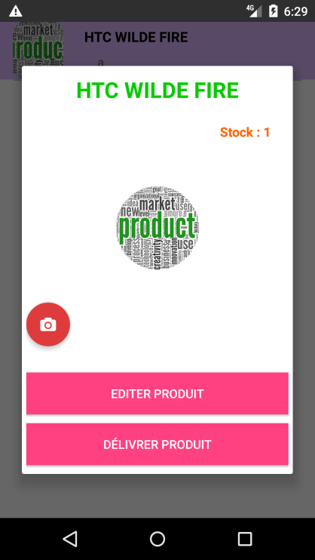
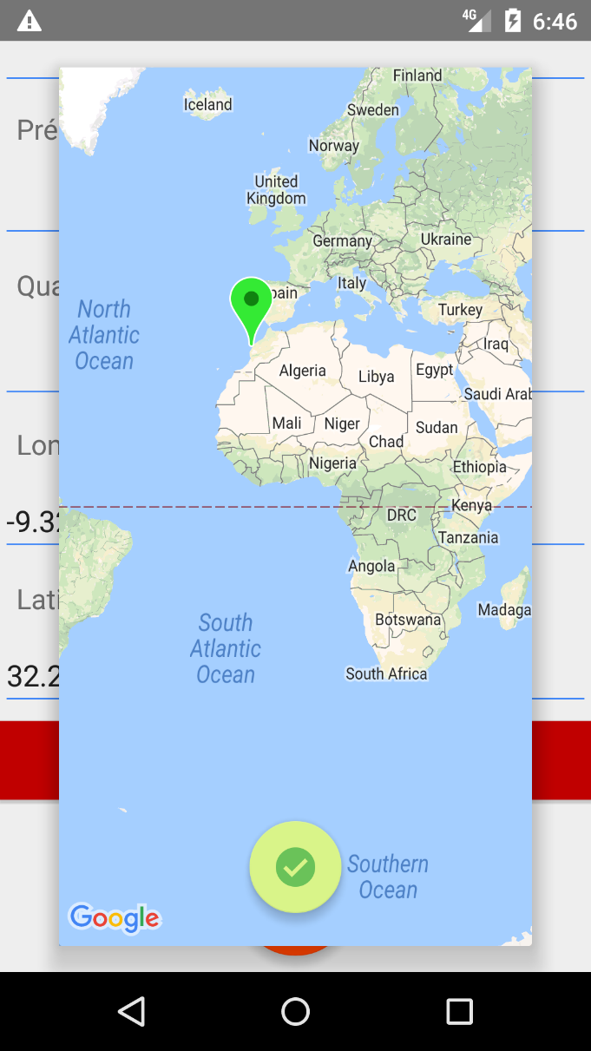
RedHawk presentation
The application interfaces : The basic windows of the application are :
Product list interface
Product options window
Product delivery interface
Select delivery credentials

Slide 8
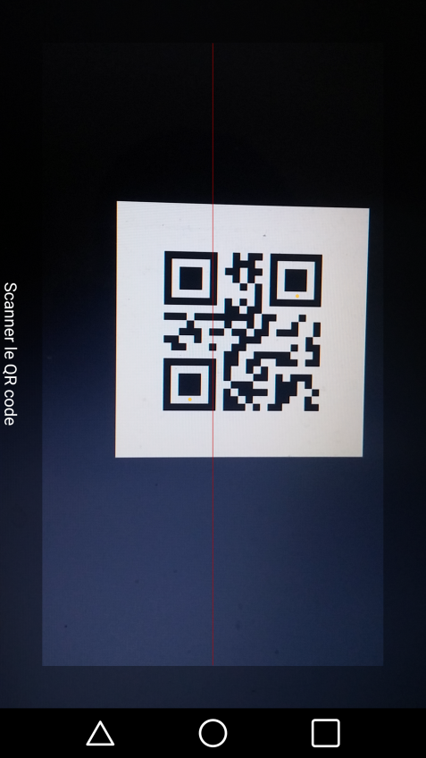
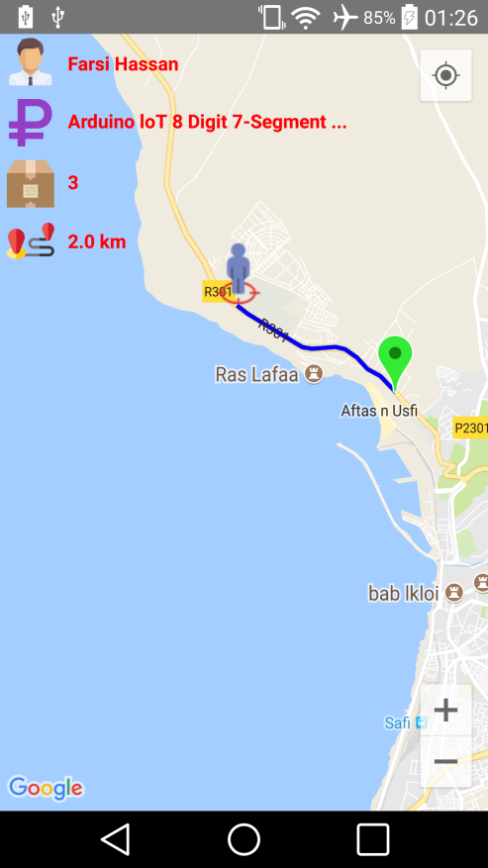
RedHawk presentation
The application interfaces : The basic windows of the application are :
QR code scanner
The information card

Slide 9
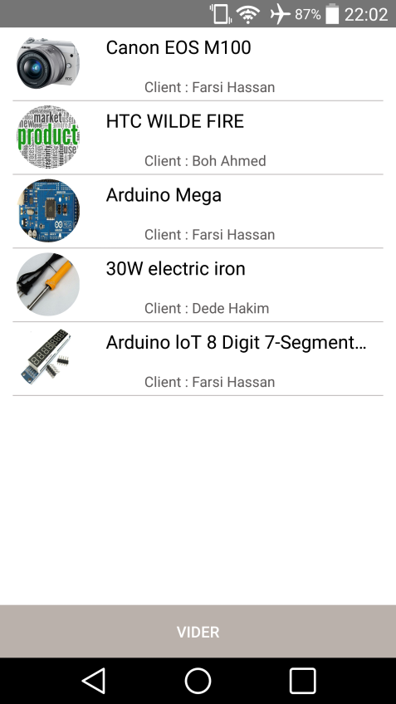
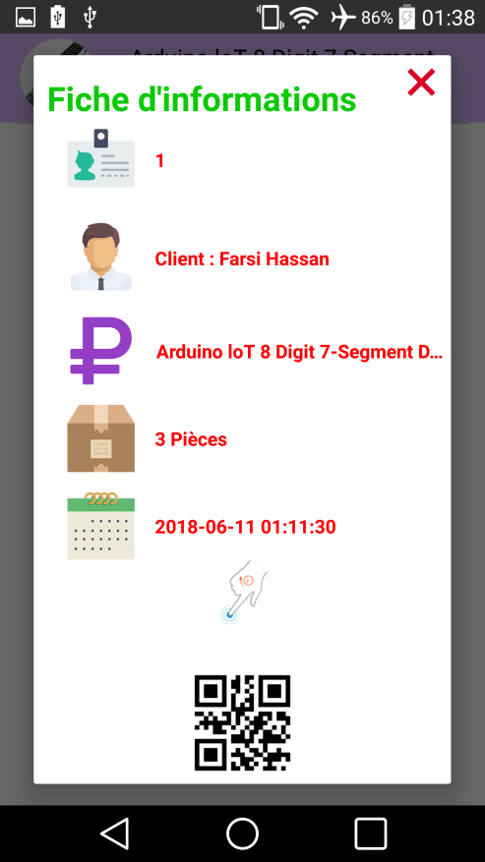
RedHawk presentation
The application interfaces : The basic windows of the application are :
Order being delivered
Delivery information interface

Slide 10
Microservice architecture
RedHawk Application Services :
Order Service : The service that deals with the costumers orders (our focus).
Product Service : Product management (our focus).
Delivery Service : Manage the order delivery process.
Employees Service : The product warehouse Employee management.
Customer Service : Customer management.
API Gateway : Calls all other services including the “Service registry”.
Service registry : Used by all the services to register and by the “API Gateway“
to provide communication information.

Slide 11


Demo
Service call
Client (Browser or Postman)
Register
Get registry
(7) Client
Response
(1) Request
All arrows are REST type of communication
<API Gateway>
Spring Cloud Gateway
(2) Get registry
<Service registry>
Eureka Netflix
(6)
Register
(3) Service call
(5)
Order Service
OpenFeign
Product
Service
(4) stockCheck() / getProductByid ()

Slide 12
The process
Step 1 : Create two Spring boot projects (order_service and product_service) with the (web, eureka-client) dependencies for both projects.
Step 2 : Configure the two projects via the application.properties or .yml file.
Step 3 : Define the necessary classes and each service controller.
Step 4 : Create the OpenFeign proxy interface and establish communication between the two services.
Step 5 : Create the API Gateway spring boot project using the spring could gateway dependency.
Step 6 : Create and configure the eureka server.
Step 7 : Configure the other_service and the product_service to auto register to the eureka server and the API Gateway to use dynamic routing.
Step 8 : Run and test.

Slide 13
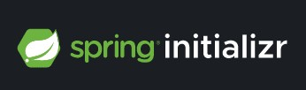
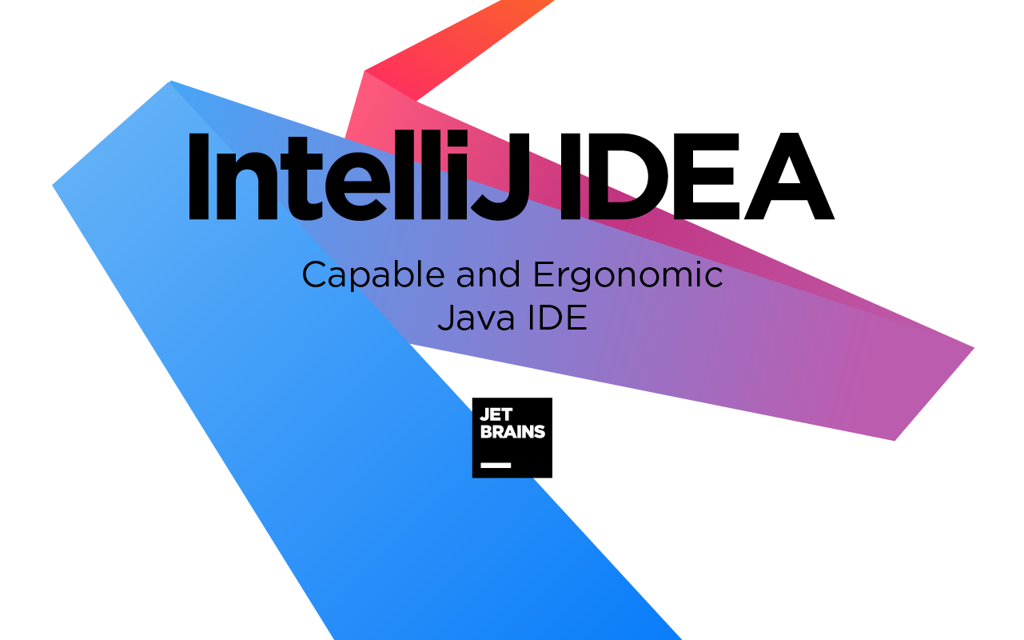
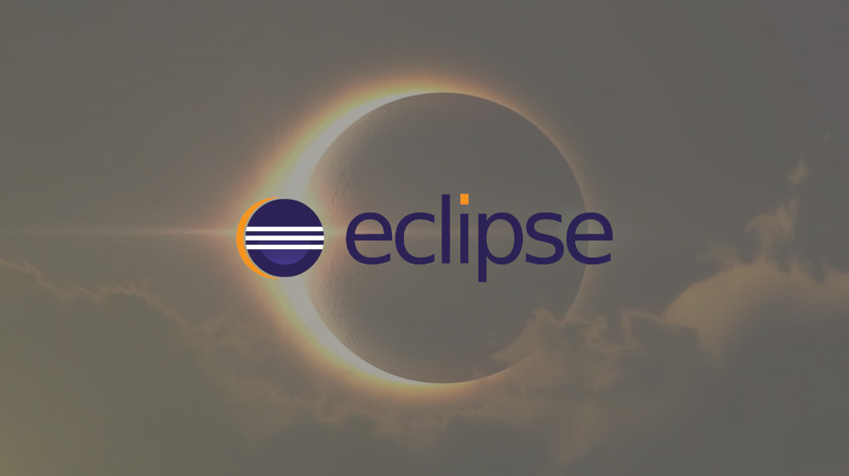
Step 1: Create the Spring boot projects
Intellij
Eclipse
<dependency> <groupId>org.springframework.boot</groupId> <artifactId>spring-boot-starter-web</artifactId> </dependency>
<dependency> <groupId>org.springframework.cloud</groupId> <artifactId>spring-cloud-starter-netflix-eureka-client</artifactId> </dependency>

Slide 14
Step 2: order_service and product_service configuration
As we have not yet implemented the eureka server, we need to prevent the two services from being registered to a server that does not exist.
Another important piece of configuration is the service name, as it will be used to specify the service to be called.
server.port=8091 #application name to use in the registry server spring.application.name=product-service #disable the Eureka Discovery Client,
as we did not create a registry server yet spring.cloud.discovery.enabled=false
server.port=8090 #application name to use in the registry server spring.application.name=order-service #disable the Eureka Discovery Client,
as we did not create a registry server yet spring.cloud.discovery.enabled=false
product_service
order_service

Slide 15
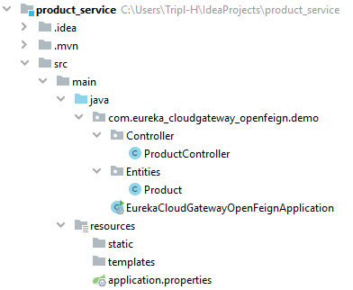
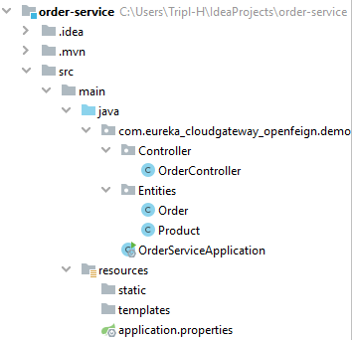
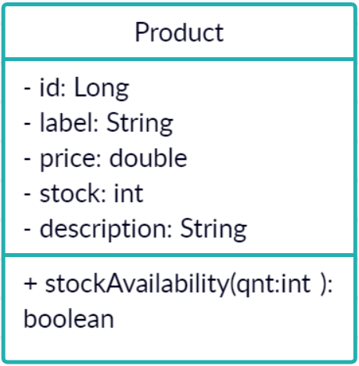
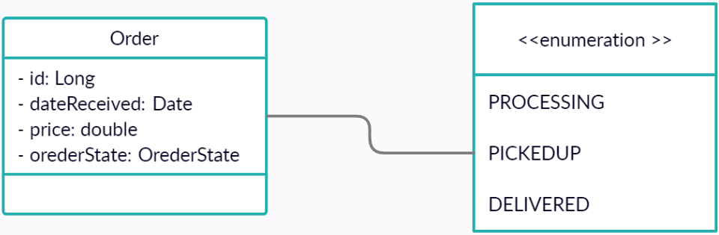
Step 3: order_service and product_service classes
order_service
You can create the enumeration OrderState
Class in a separate file (In this structure it is preent with in the order class)
OrderState
product_service
CREATED
FAILED

Slide 16
Step 3: product_service controller
ArrayList<Product> productList = new ArrayList(Arrays.asList( new Product((long) 1,"HTC Electric Shaver", 80, 10, "An electric shaver"), new Product((long) 2, "Arduino Uno", 150, 20,"A microcontroller board"), new Product((long) 3, "Canon EOS M100", 5500, 3,"Canon camera")));
@GetMapping("/Product/AllProducts") public List<Product> getProductList(){ } @GetMapping("/Product/{prodId}") public Product getProductByid(@PathVariable int prodId){ } @GetMapping("/Product/Stock/{prodId}/{qnt}") public boolean stockCheck(@PathVariable int prodId, @PathVariable int qnt){ }

Slide 17
Step 3: order_service controller
ArrayList<Order> orderList = new ArrayList(Arrays.asList( new Order((long) 1, 160, new Date(),Order.OrderState.PROCESSING), new Order((long) 2, 360, new Date(), Order.OrderState.PROCESSING), new Order((long) 3, 5500, new Date(), Order.OrderState.PROCESSING)));
@GetMapping("/Order/AllOrders") public List<Order> getProductList(){ } @GetMapping("/Order/{orderId}") public Order getProductByid(@PathVariable int orderId){ } @GetMapping("/Order/new/{prodId}/{qnt}") public Order createOrder(@PathVariable long prodId, @PathVariable int qnt){ }

Slide 18
Step 4 : OpenFeign
Add the OpenFeign dependency.
Add @EnableFeignClients annotation to the OrderServiceApplication class.
Create a productproxy interface that exposes the product_service necessary endpoints signatures (In our case : stockCheck() and getProductByid() ).
Replace the WebClient methods in the order_service controller by the two methods declared in the productproxy interface.

Slide 19
Step 4 : OpenFeign
@SpringBootApplication @EnableFeignClients public class OrderServiceApplication { public static void main(String[] args) { SpringApplication.run(OrderServiceApplication.class, args); } }
@FeignClient(name = "PRODUCT-SERVICE") public interface Productproxy { @GetMapping("/{prodId}") public Product getProductByid(@PathVariable long prodId); @GetMapping("/Stock/{prodId}/{qnt}") public boolean stockCheck(@PathVariable long prodId, @PathVariable int qnt); }
boolean isProductAvailable = productproxy.stockCheck(prodId, qnt);

Slide 20
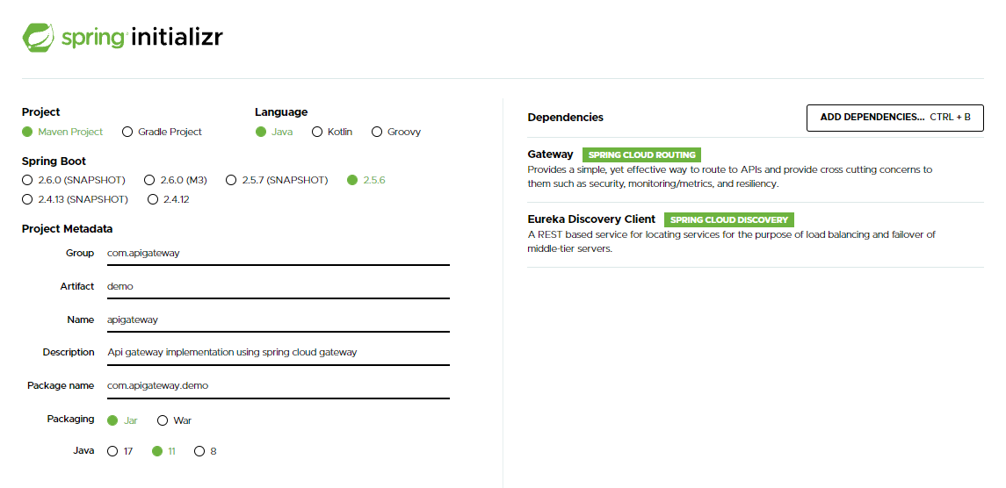
Step 5: API Gateway using spring could gateway
We use Eureka client as some of the services may want to communicate with the API Gateway.
Whenever the Gateway is implemented, it can be configured to work statically (without Eureka/Hard code addresses) or dynamically.

Slide 21
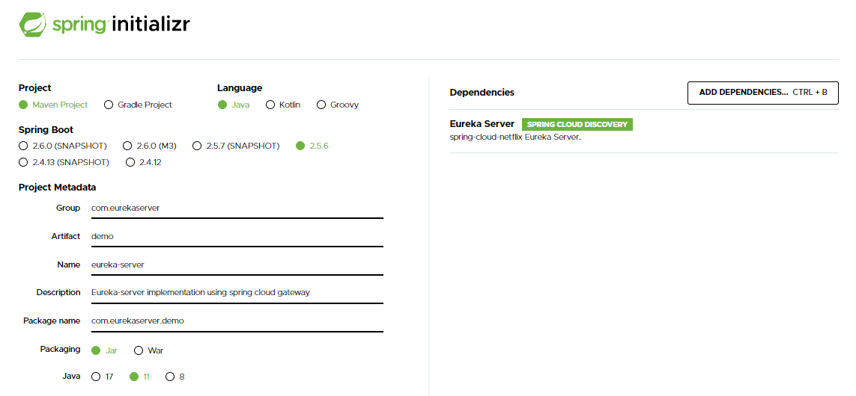
Step 6 : eureka-server
server.port:8761 spring.application.name=eureka-server eureka.client.registerWithEureka:false eureka.client.fetchRegistry:false
@SpringBootApplication @EnableEurekaServer public class EurekaServerApplication { public static void main(String[] args) { SpringApplication.run(EurekaServerApplication.class, args); } }

Slide 22
Step 6: Auto register to the eureka server
In order for the services to be able to register on eureka server, we need to change or delete the property we’ve added while creating the two services:
spring.cloud.discovery.enabled=true
Services need to know the eureka server location in order to register themselves, to do that we need to add the following line :
Eureka by default runs on port 8761.
#eureka server location eureka.client.service-url.defaultZone:http://localhost:8761/eureka/

Slide 23
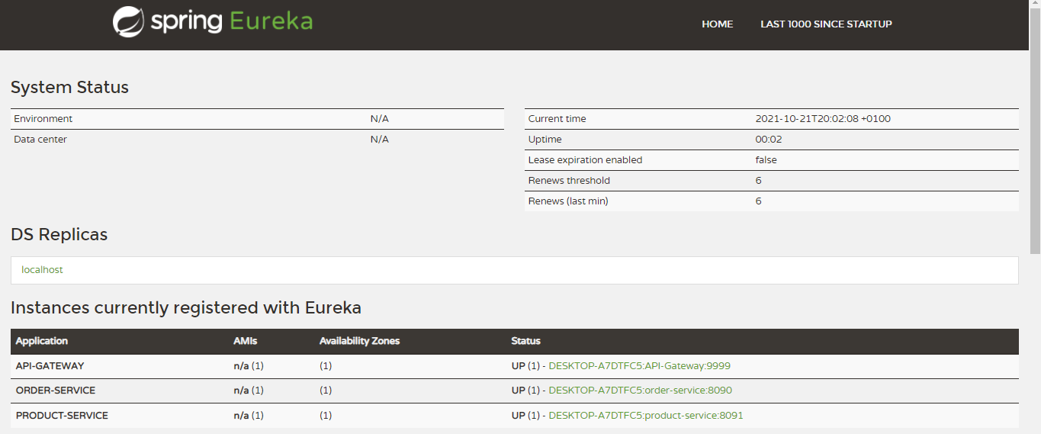
Step 6: Auto register to the eureka server
You can use the following address to check if the services have registered successfully : http://localhost:8761/

Slide 24
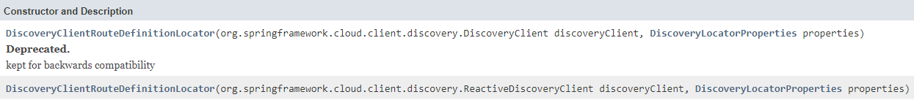
Step 7: API Gateway / eureka-server configuration
In order for the API gateway to be able to create dynamically the service route using the eureka server, we need to add the following configuration :
@Bean public RouteDefinitionLocator discoveryClientRouteDefinitionLocator(
ReactiveDiscoveryClient discoveryClient,
DiscoveryLocatorProperties properties) {
return new DiscoveryClientRouteDefinitionLocator(discoveryClient, properties);
}

Slide 25
Step 7: API Gateway / eureka-server configuration
@Bean public RouteLocator customRouteLocator(RouteLocatorBuilder builder) { return builder.routes() .route("product_service", r -> r.host("**.localhost:9999") .and() .path("/Product/**") .uri("http://localhost:8091/")) .route("order_service",r -> r.host("**.localhost:9999") .and() .path("/**") .filters(f -> f.prefixPath("/Order")) .uri("http://localhost:8090/")) .build(); }
In case you want to use static routing
API Gateway spring class

Slide 26
Step 8 : Run and test
Run the four services (The first one must be the eureka server in order to let the others subscribing to it).
Open the eureka server page at : http://localhost:8761/.
Try to use the product_service and the order_service exposed APIs via the API Gateway service using the following URL syntax :
API-Gateway-Host : API-Gateway-Port / Service-name / EndPoint

Slide 27
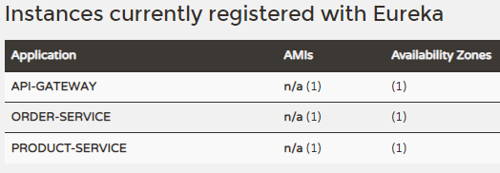
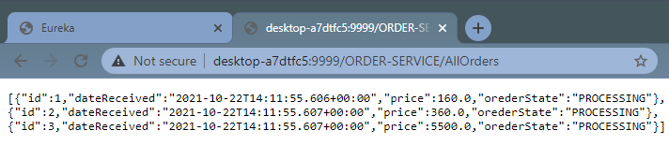
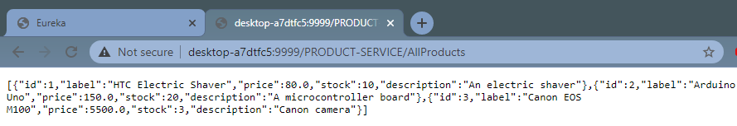
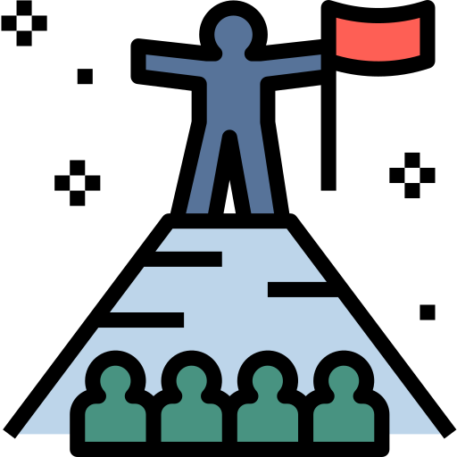
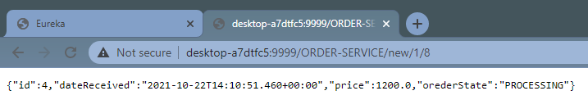
Step 8 : Run and test

Slide 28

Step 8 : Run and test

Slide 29
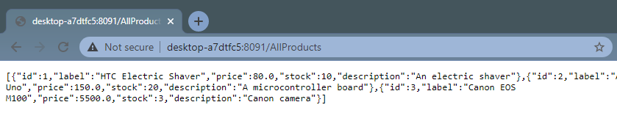

Remarks
Apparently you can access the other services endpoints directly.
Solutions :
Deploying with Kubernetes : Configures a cluster only accessible via the API gateway.
Network isolation : Configure firewalls to allow only the gateway access.
Application layer interception : Create an interceptor to check whether the request comes from the gateway.

Slide 30
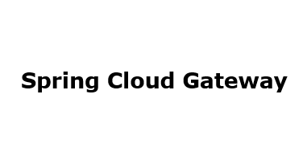


OpenFeign

